Slide 1

Task 23
Data Visualizations using Seaborn
Name: Basel Amr Barakat
Email: baselamr52@gmail.com

Slide 2
Requirement One
Basic Plotting with Seaborn.

Slide 3
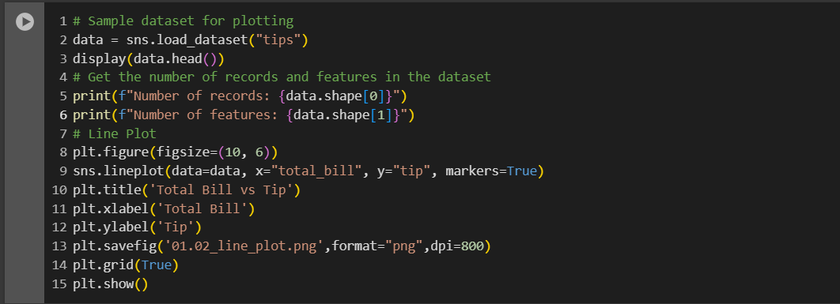
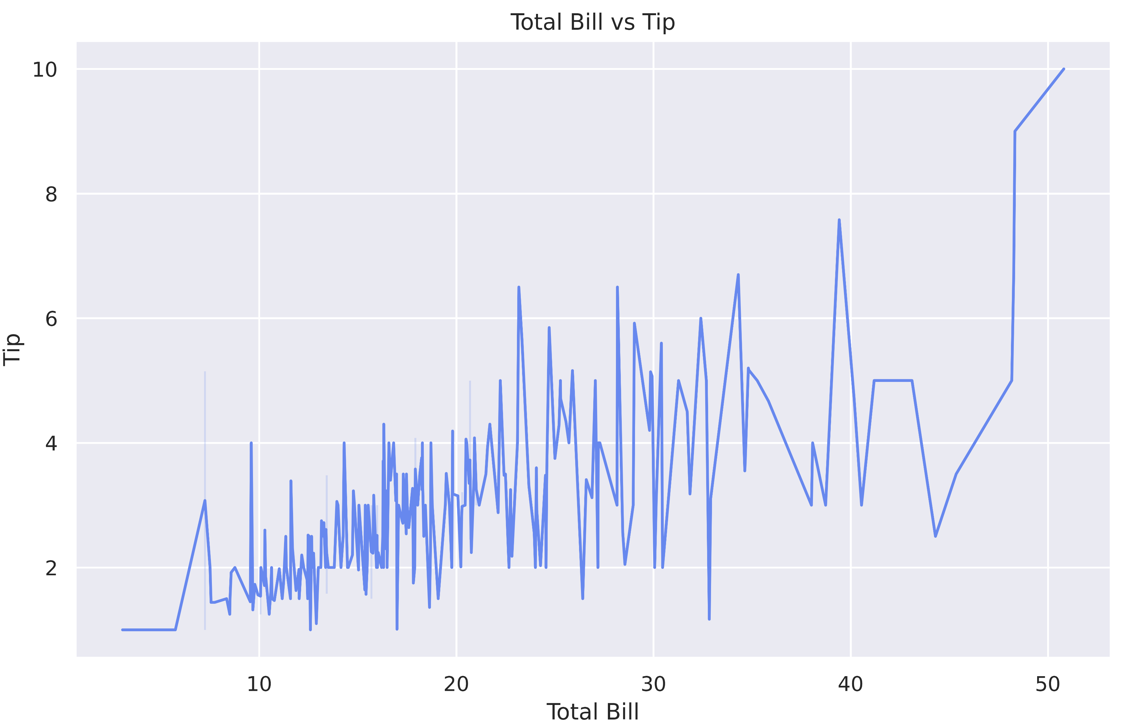
1.1 Use Seaborn to create a line plot

Slide 4
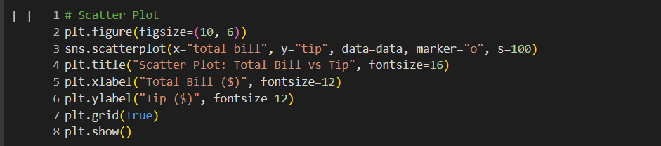
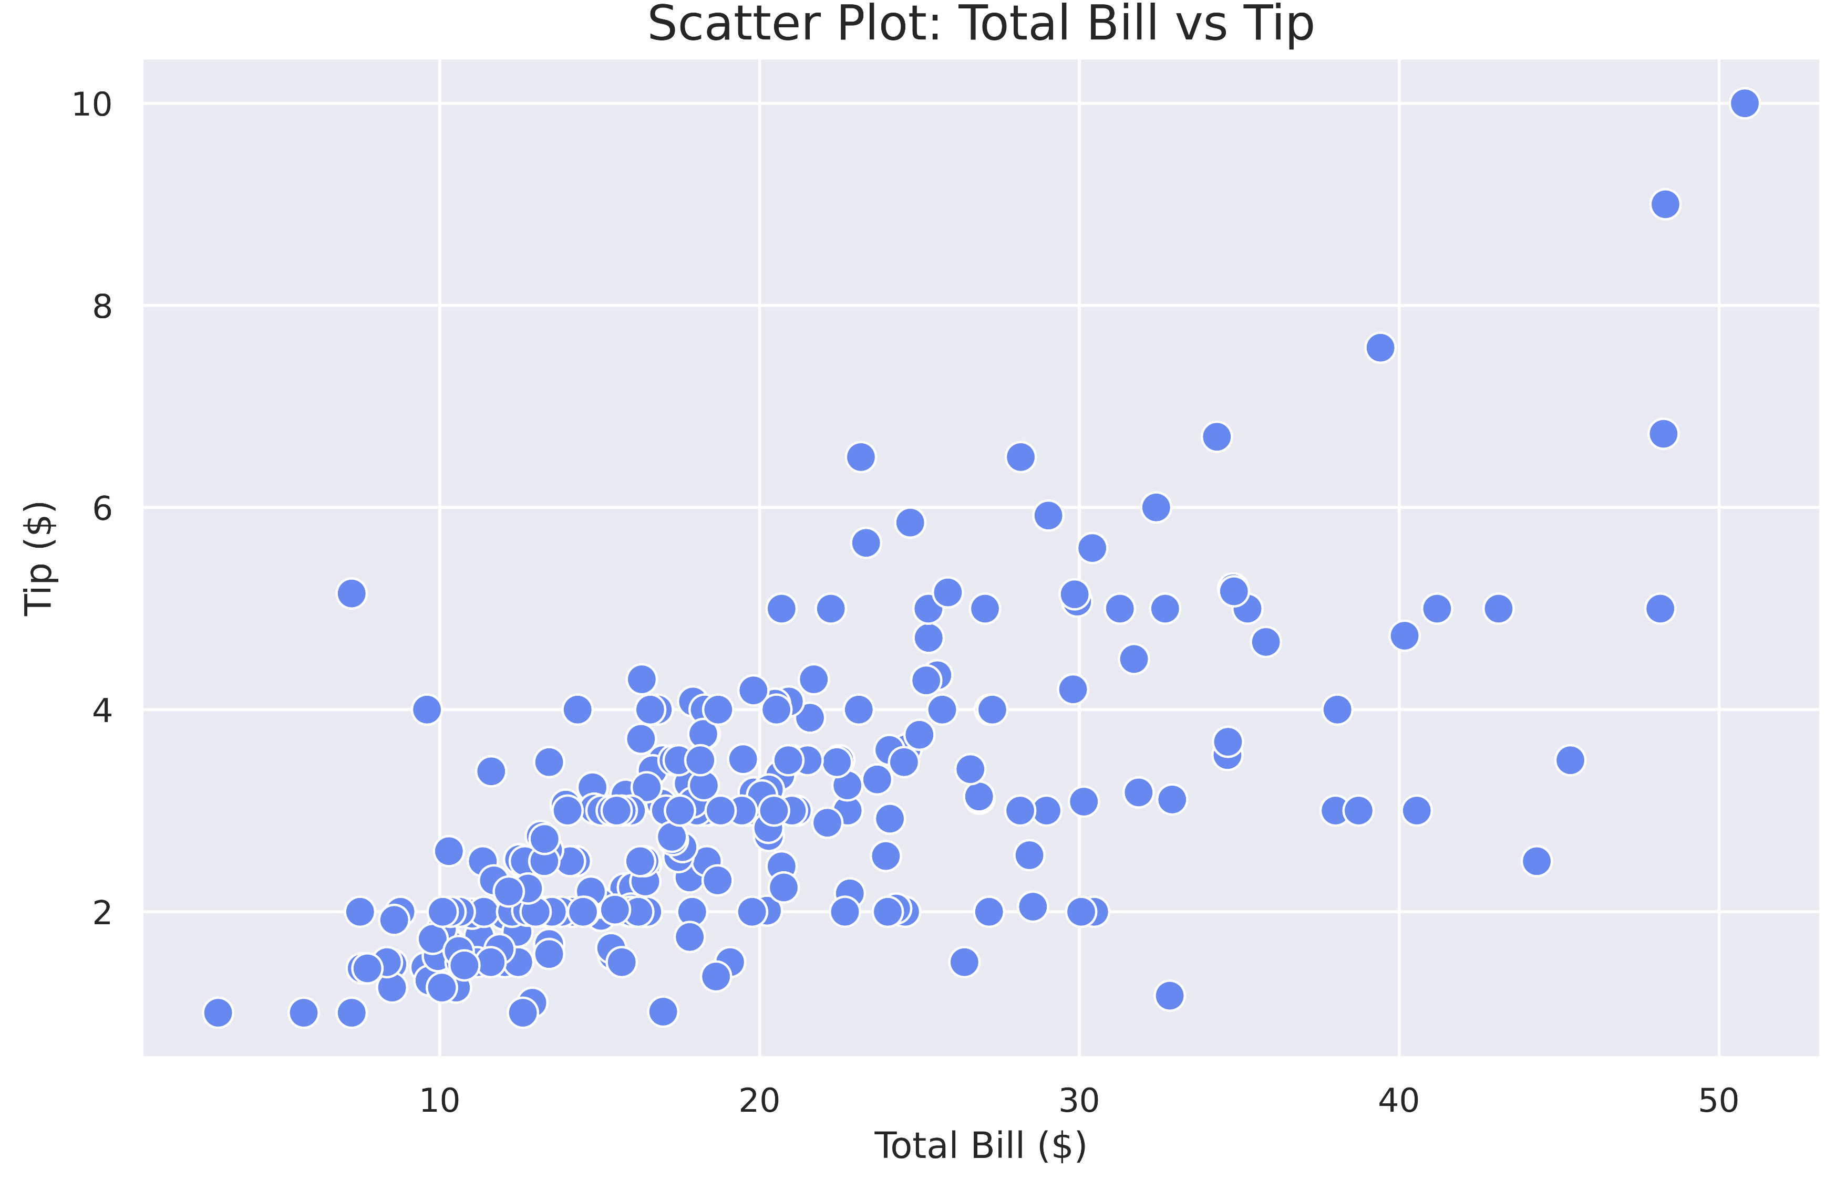
1.2 Use Seaborn to create a scatter

Slide 5
Requirement Two
Distribution and Categorical Data Visualization

Slide 6
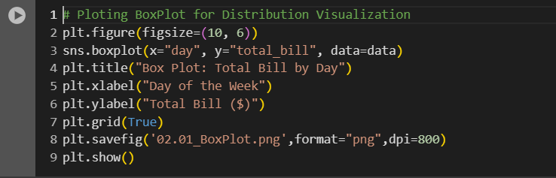
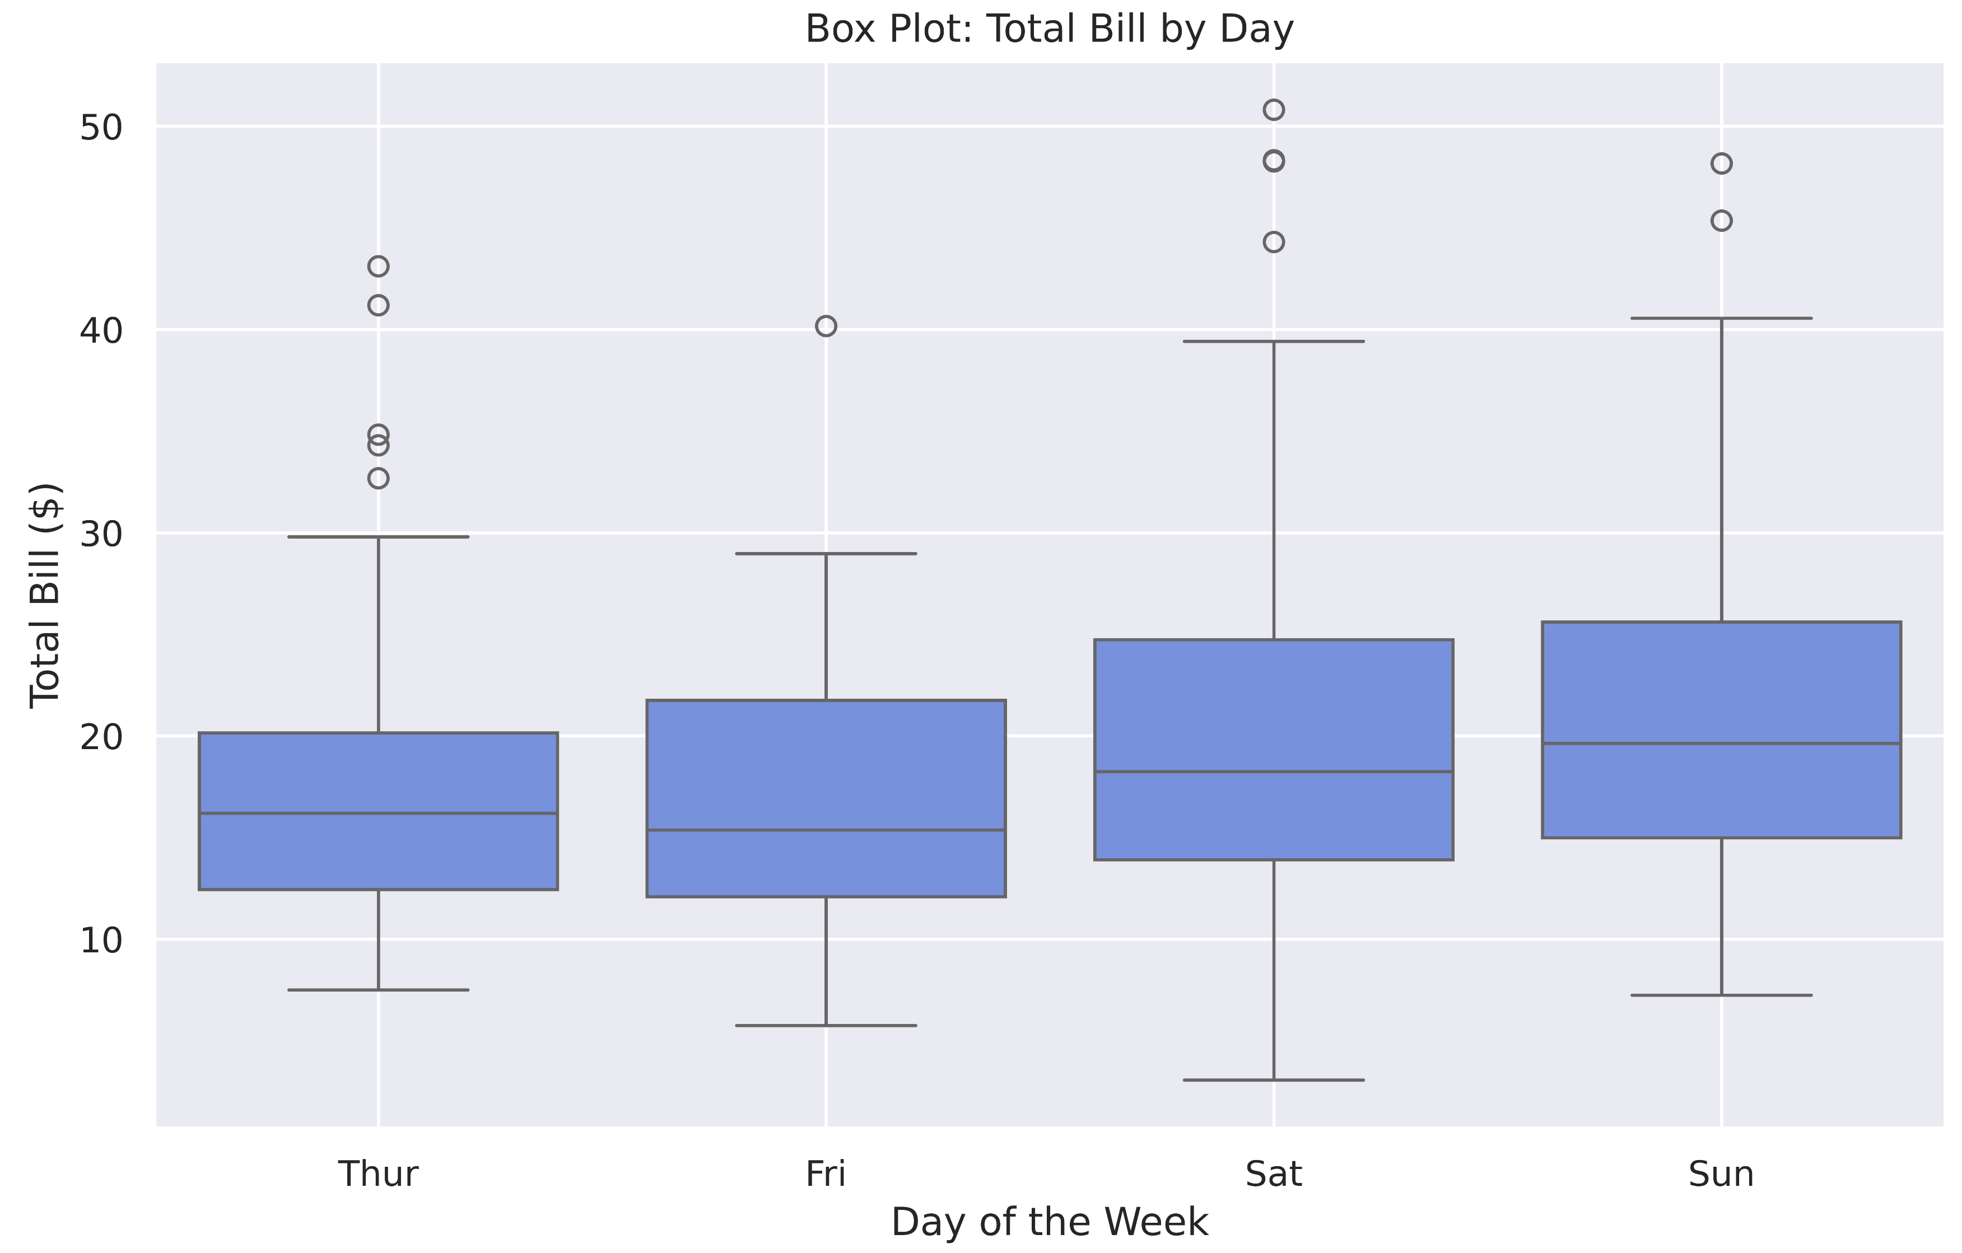
2.1 Box Plot for Distribution Visualization

Slide 7
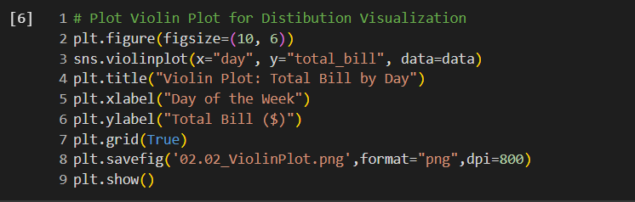
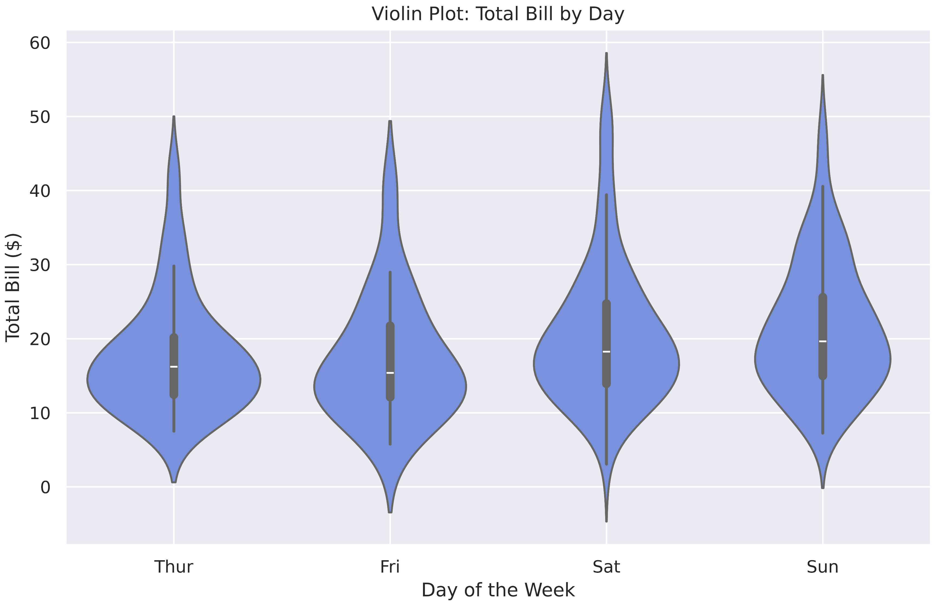
2.2 Violin Plot for Distribution Visualization

Slide 8
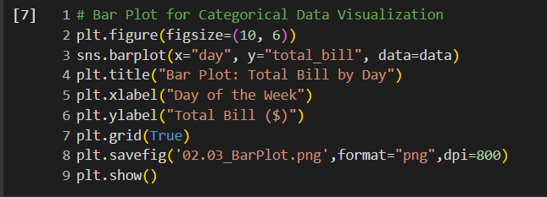
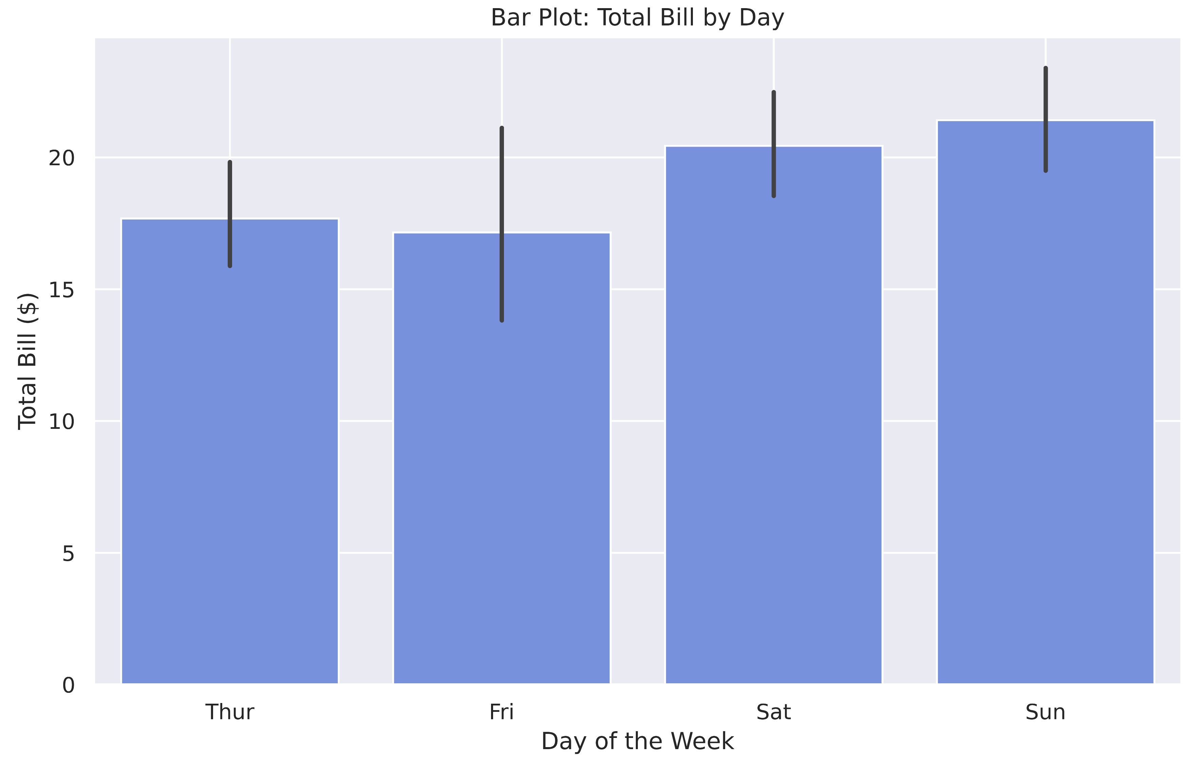
2.3 Bar Plot for Categorical Data Visualization

Slide 9
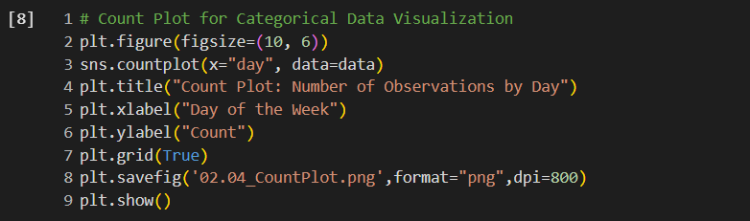
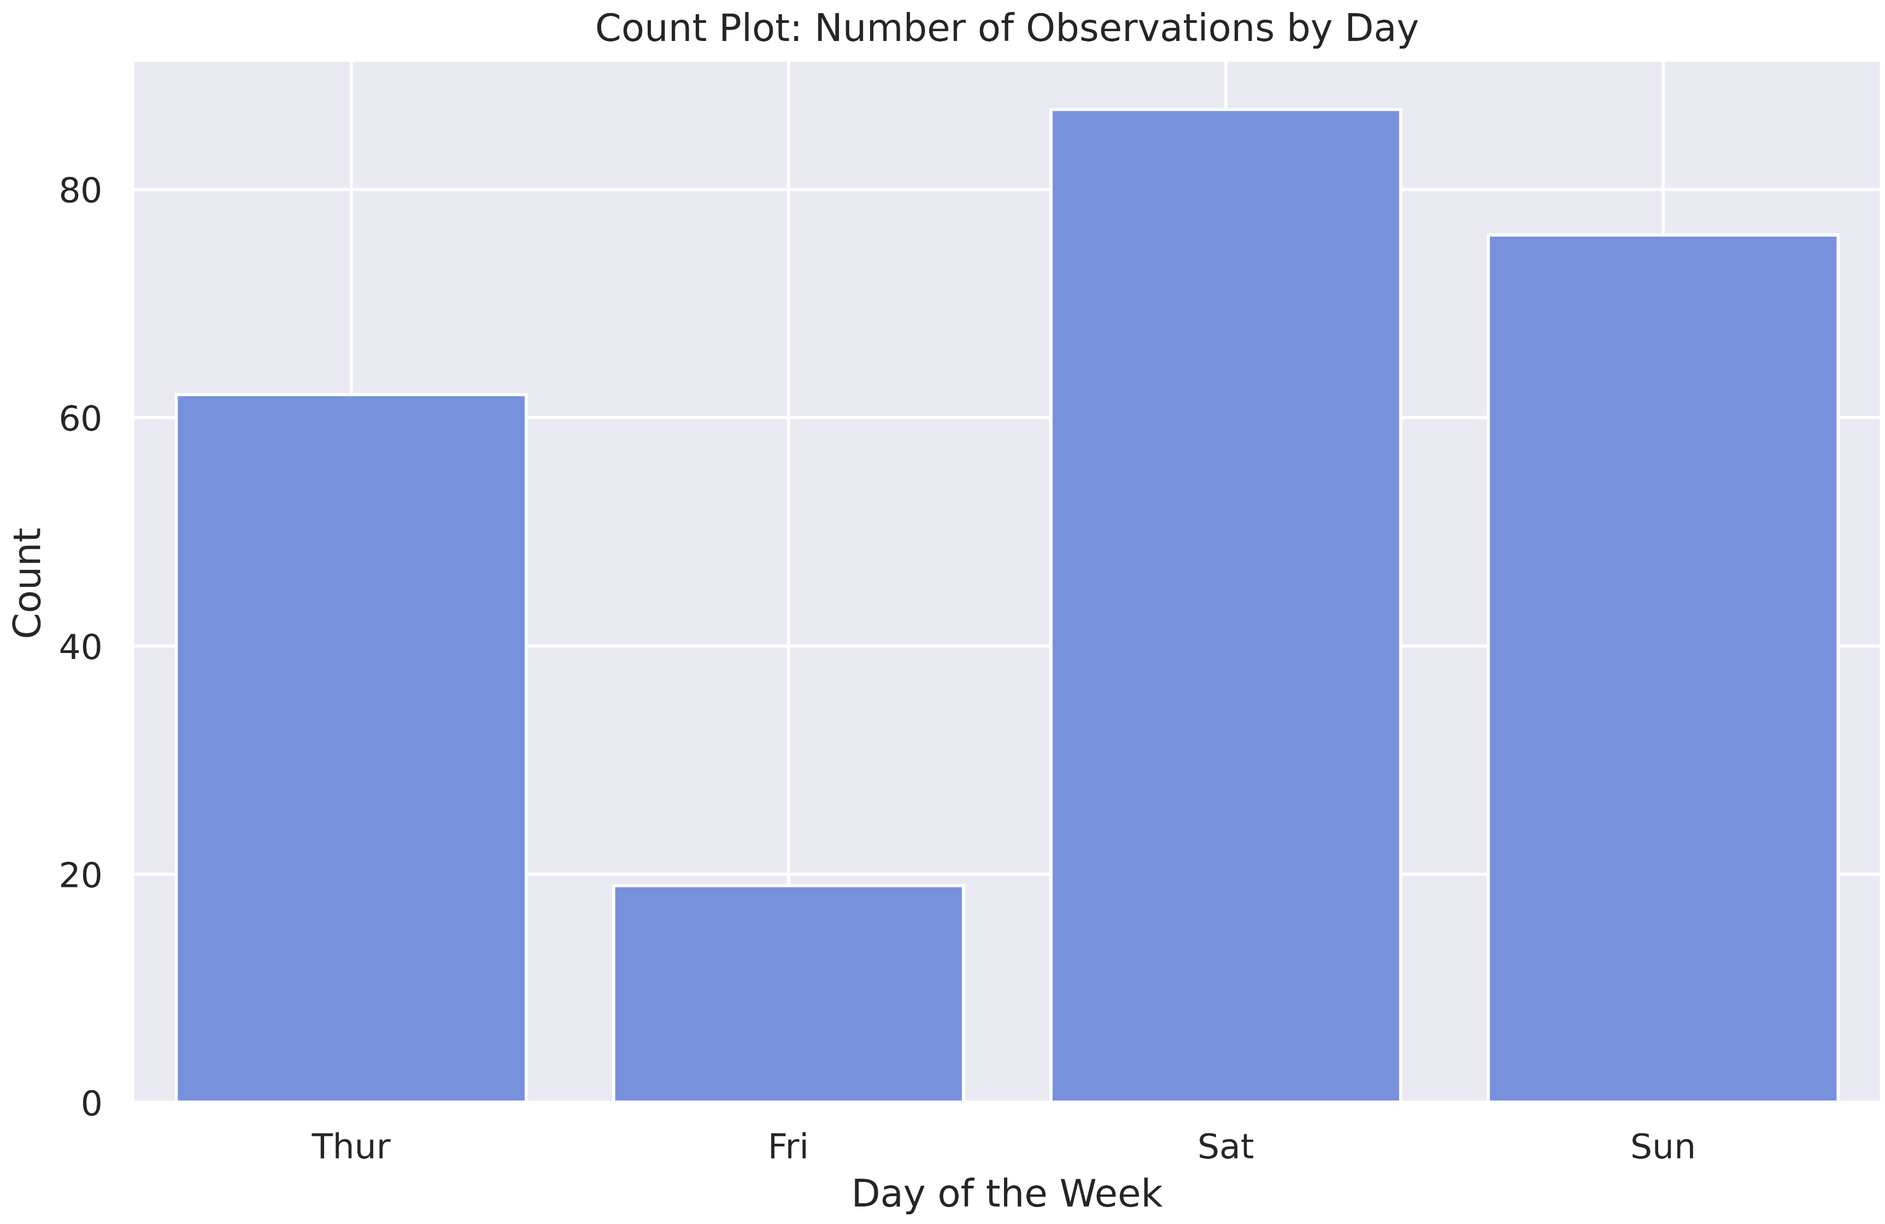
2.4 Count Plot for Categorical Data Visualization

Slide 10
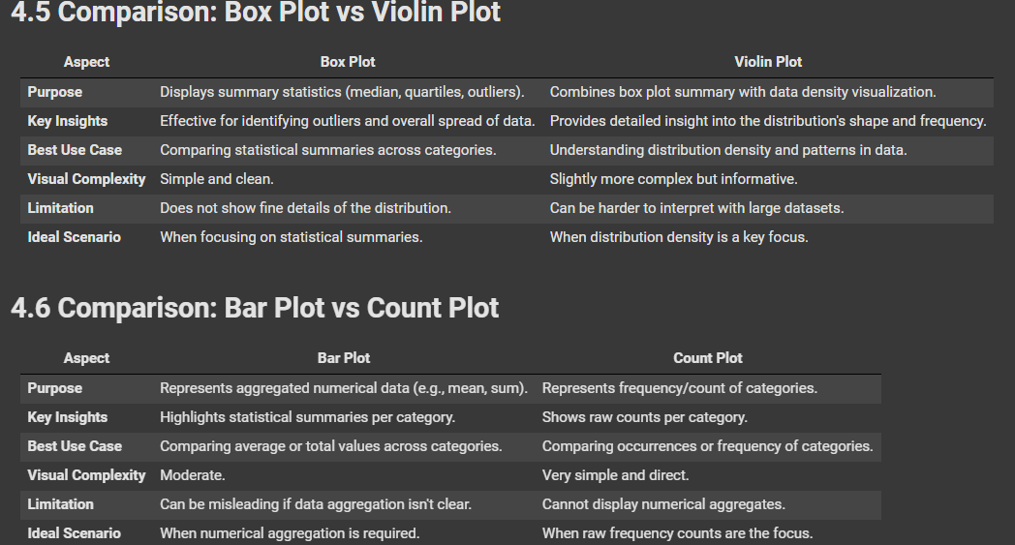
2.5 Comparison

Slide 11
Requirement Three
Correlation Visualization with Heatmap.

Slide 12
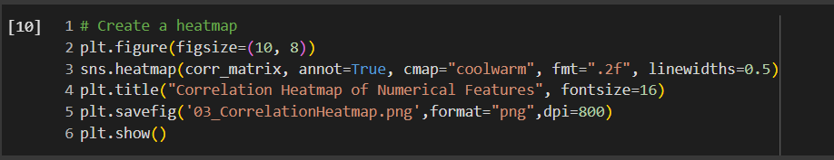
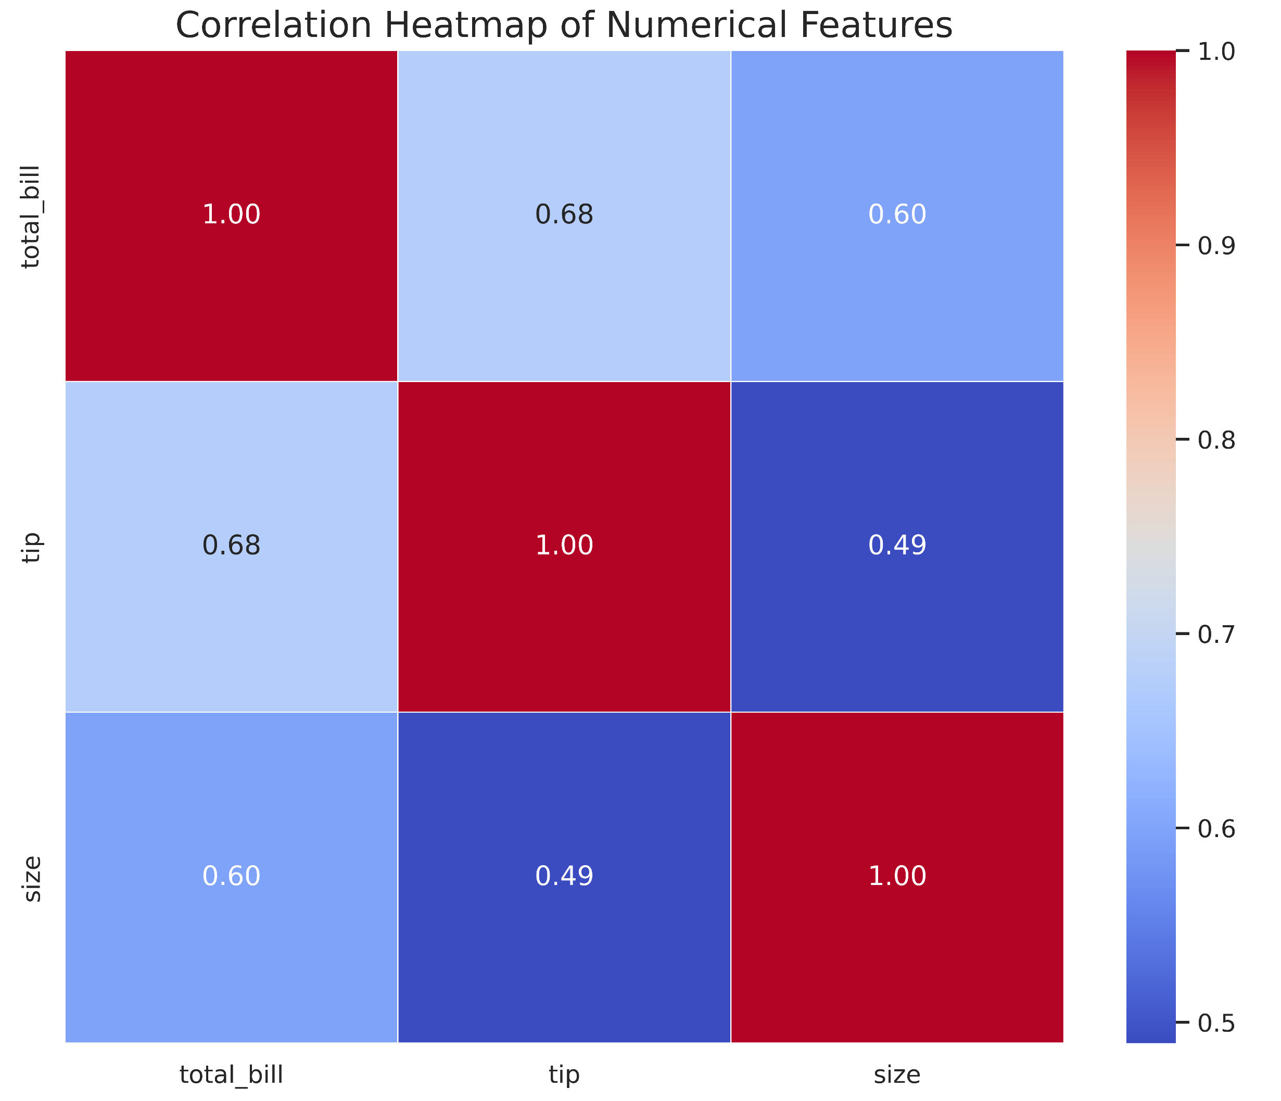
3.1 Heatmap with Correlation

Slide 13
Requirement Four “Extra”
Advanced Pair Plots and Joint Plots

Slide 14
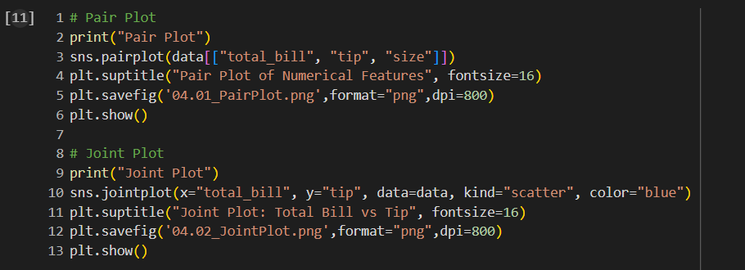
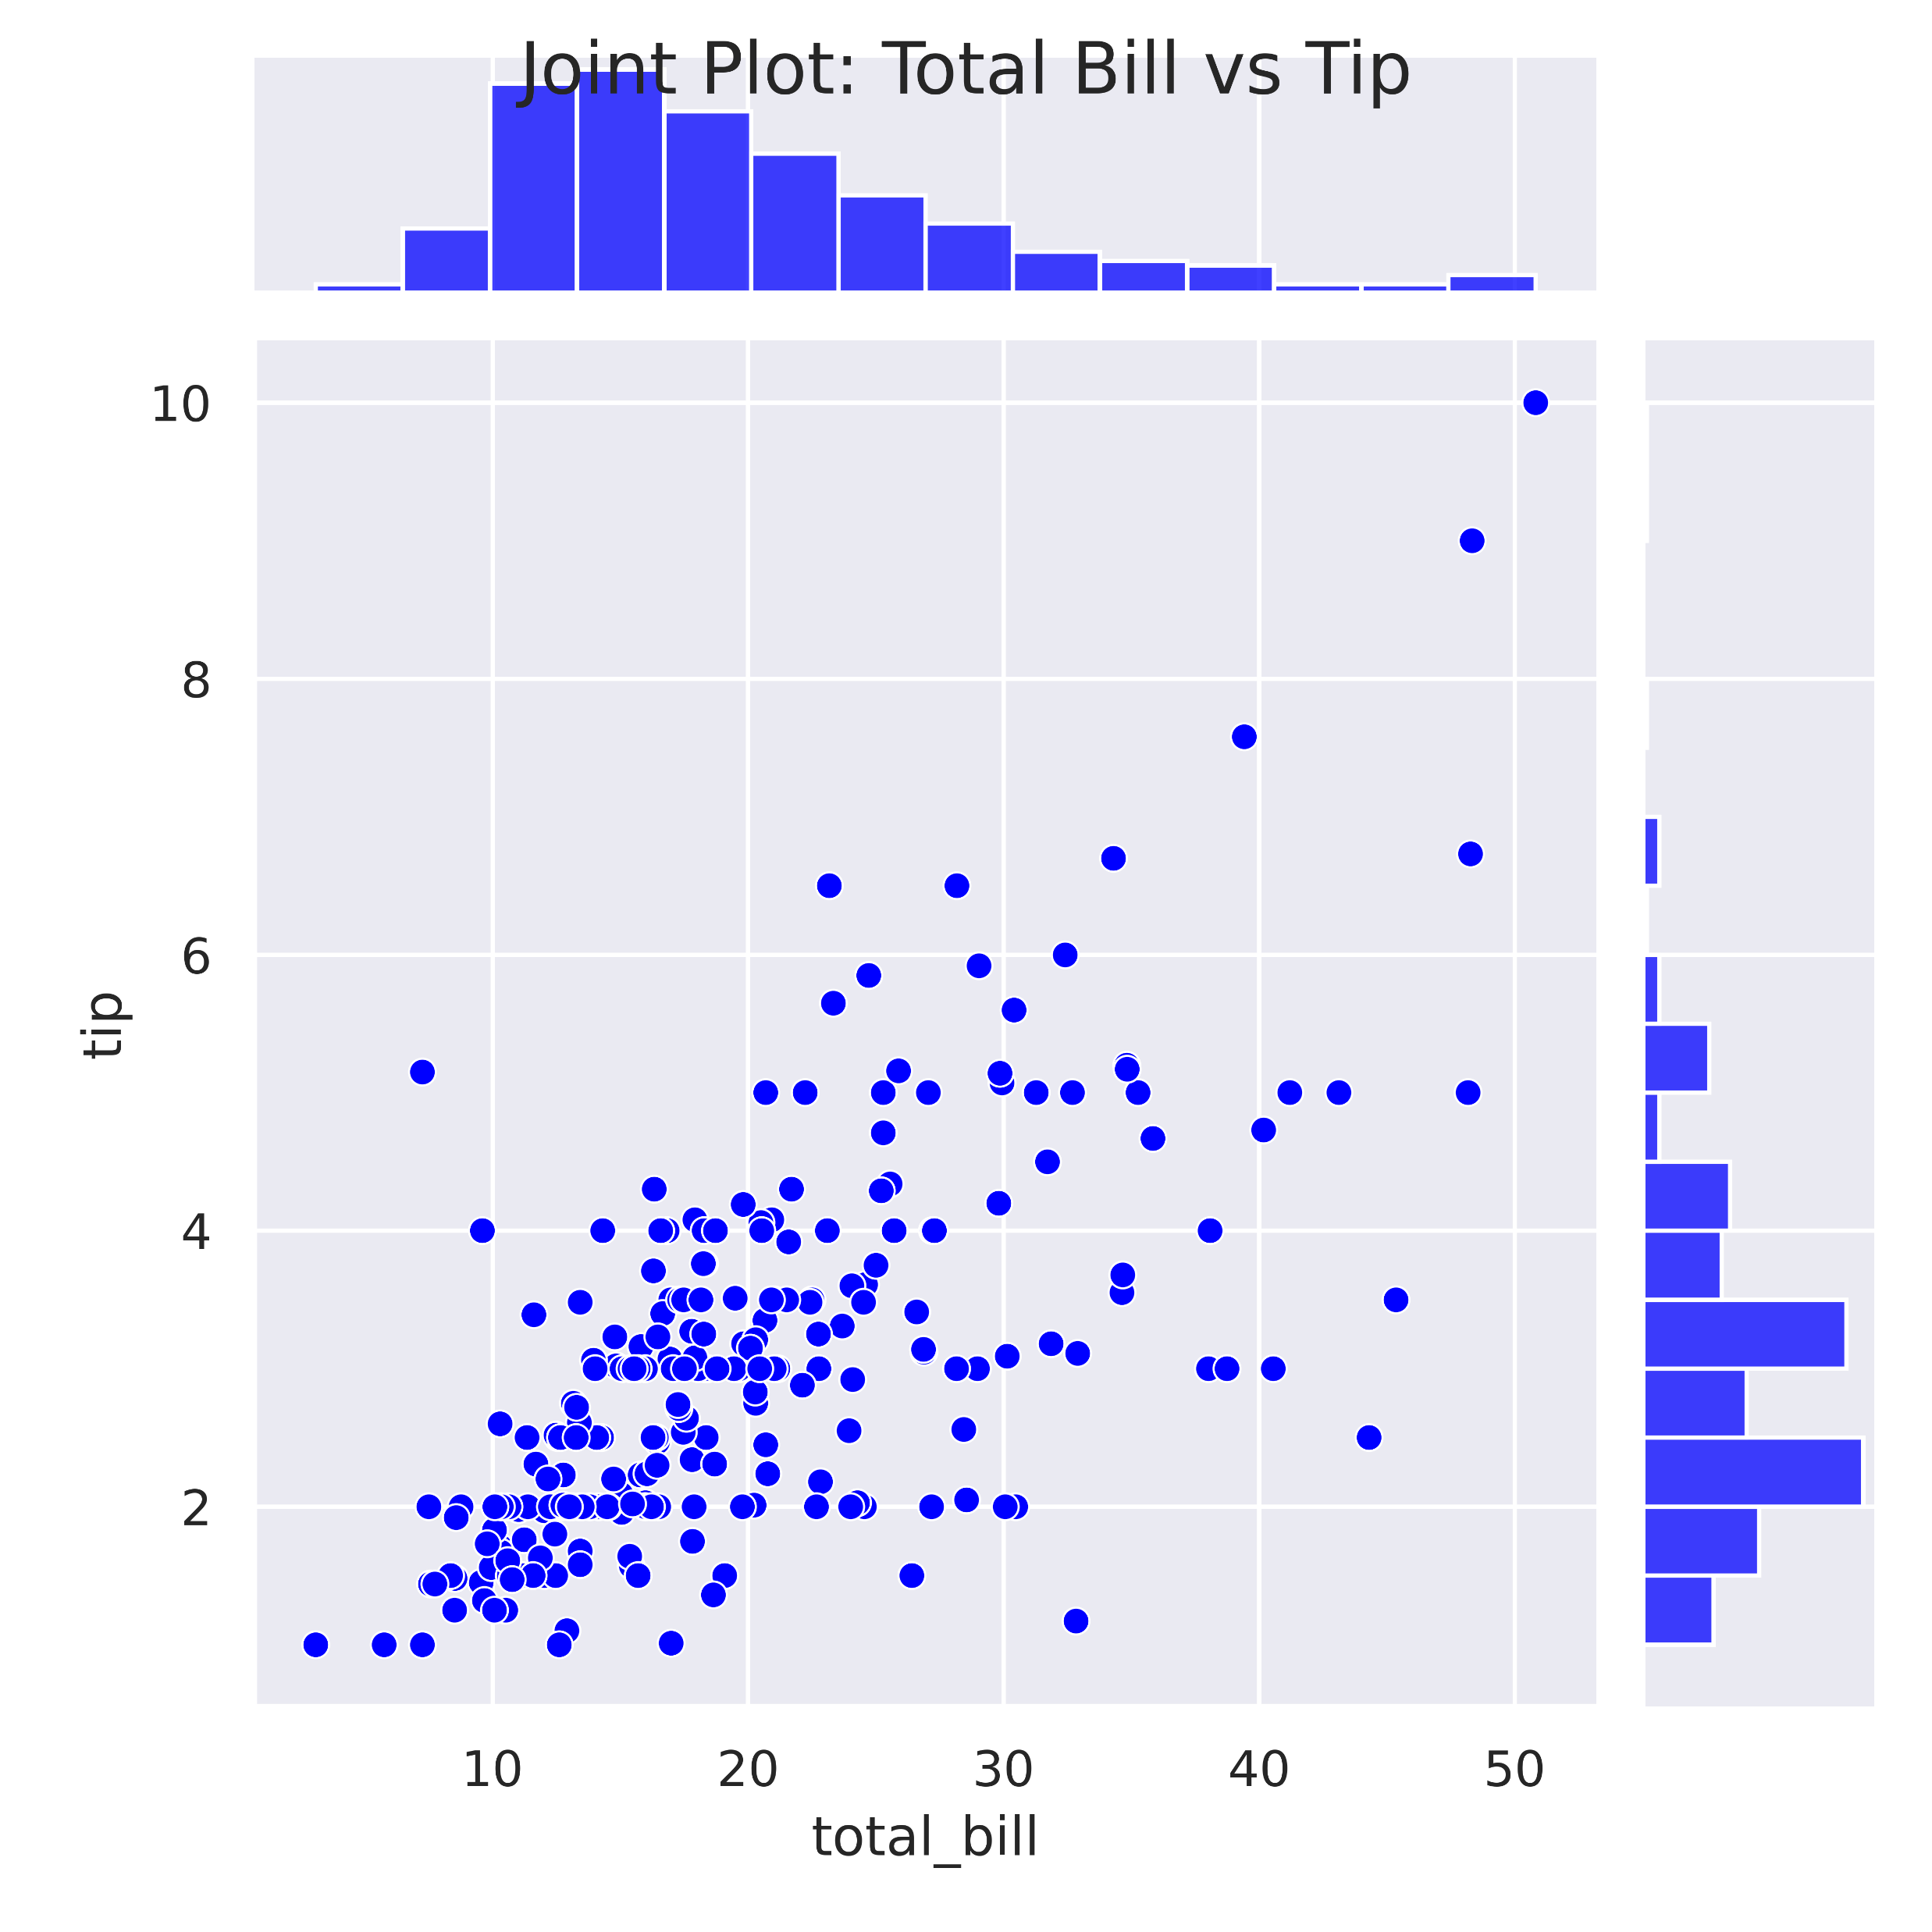
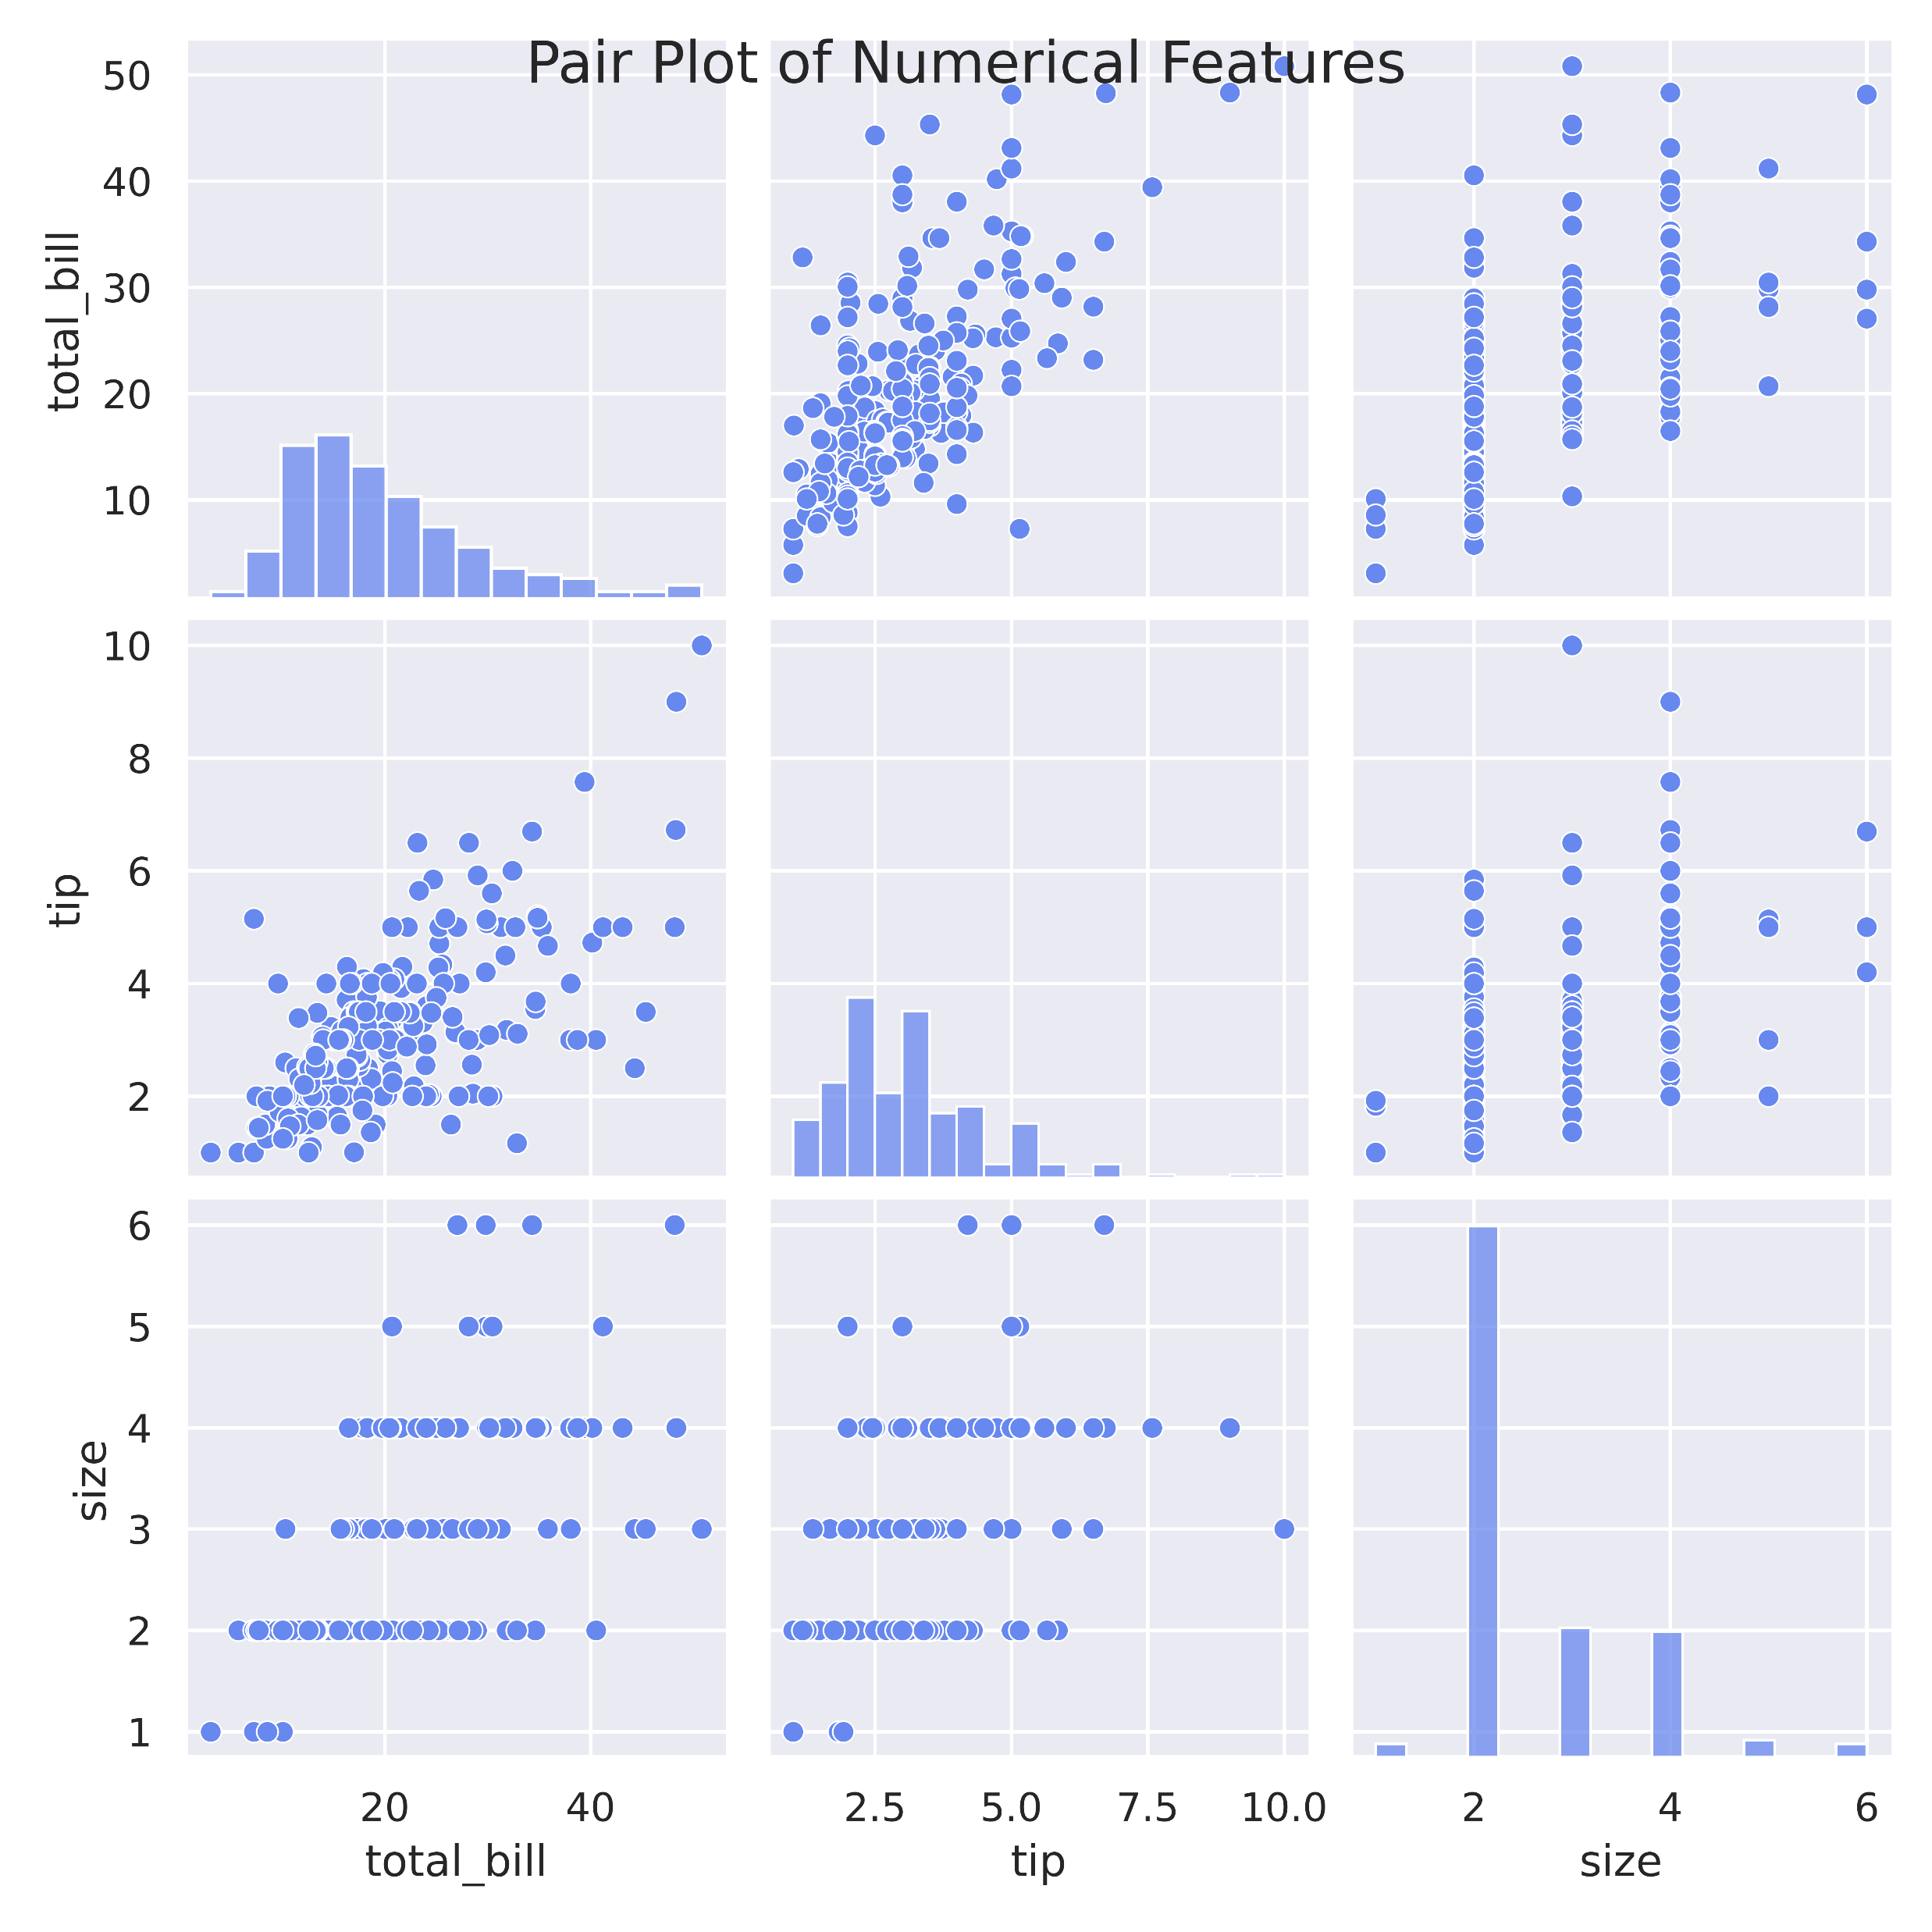
4.1 Advanced Pair and Joint Plot

Slide 15
Requirement Five “Extra”
Time Series Data Visualization

Slide 16
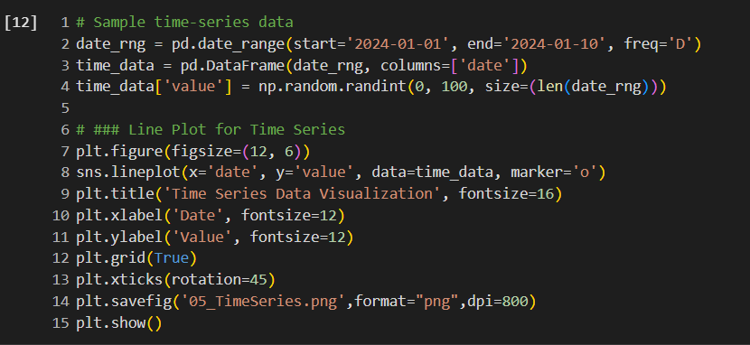
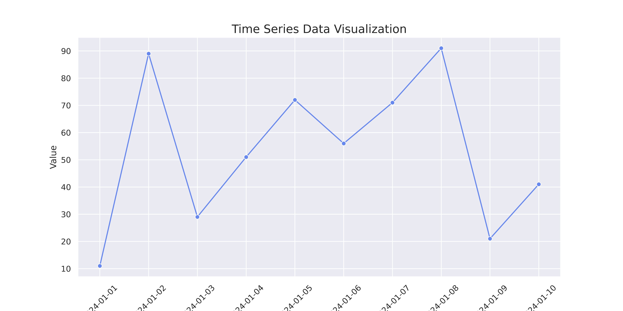
4.1 Advanced Pair and Joint Plot

